Slide 1
NO.6, OLD P.P.AMMAN KOIL STREET, LORD SIRINIVASA COLONY, PAMMAL, PALLAVARAM, CHENNAI-600075.

Slide 2
A Few Words About Us
JR Industries is basically a full-fledged CNC Machine Shop with conventional setup. We are doing service for Caterpillar for more than 25 Years.
Initially, we started with Caterpillar for Job work and now we are full-fledged one stop shop for Rods, Pins, Hinge, Clevis, Bars, Plate, Piston, Block, Flange, Washer, Cylinder, 2D & 3D Precision Machining.
We have full-fledged Tool Room for Jigs & Fixture for our own use.
Our company caters local customer needs and provide better service.

Slide 3
Our Vision
We at JR Industries, are committed to achieve the Total Customer Satisfaction through Understanding & fulfilling the customer requirements, Continual Improvements in all process, Involvement of all employees in every activities & Personal Health and maintaining safe & Green work place environment.

Slide 4
Our Services
We are dedicated to serve our customer 24x7 throughout the year. We have state of the art CAD and CAM division with latest software’s to execute every assignment properly with Technical support wherever required.

Slide 5
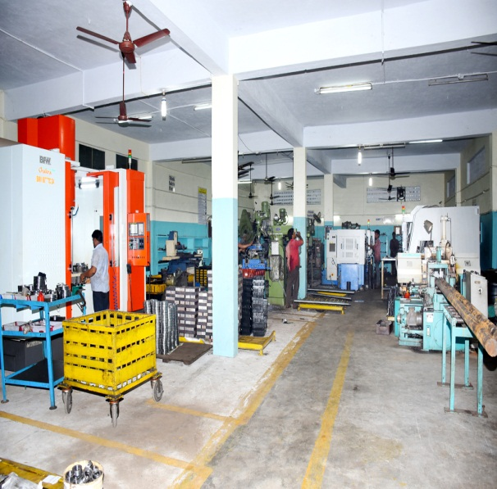
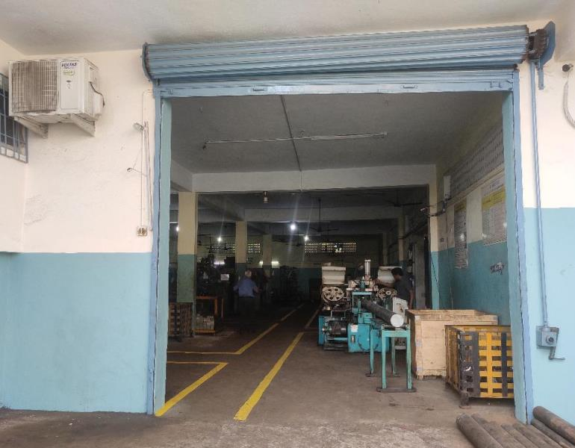
Infrastructure
JR Industries was established in the year 1995 and renewed during the year 2013 with a factory area of 12000 Sq. Ft.
Smart working Environment equipped with advanced process flow systems with skilled worker to satisfy our job needs.

Slide 6
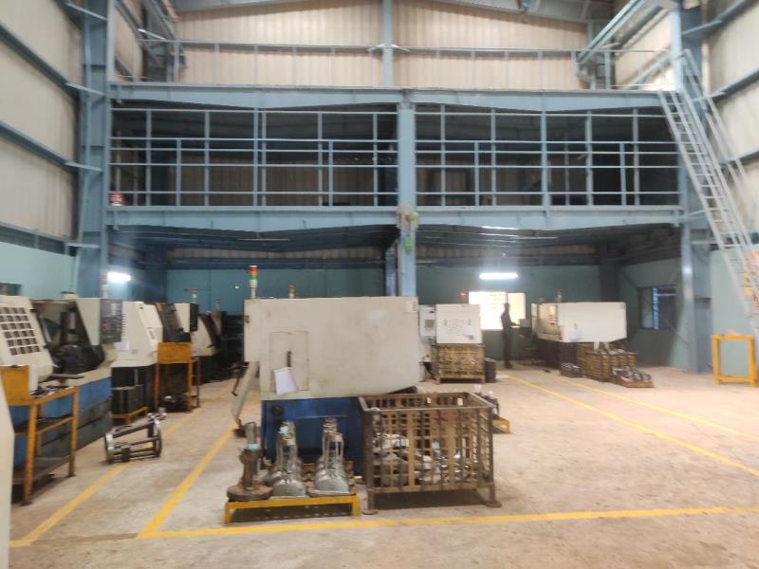
Infrastructure
With the help of super safety Services Pvt Ltd. Our Company equipped with advanced fire safety equipment's.
We are certified with ISO 9001-2015 .

Slide 7
Our Machinery
SI.NO | MACHINE NAME |  | QTY | M/C NO | CAPACITY | MAKE | YEAR OF PURCHASE
1 | CNC Lathe |  | 9 | 1 | 0-450mm | LOKESH | 2012-1
 |  |  |  | 2 | 0-500mm | PRIDE | 2014-1
 |  |  |  | 3 | 0-500mm | PRIDE | 2016-1
 |  |  |  | 6 | 0-500mm | PRIDE | 2018-1
 |  |  |  | 7 | 0-500mm | PRIDE | 2018-1
 |  |  |  | 8 | 0-500mm | PRIDE | 2019-1
 |  |  |  | 5 | 0-750mm | PRIDE | 2019-1
 |  |  |  | 4 | 0-750mm | PRIDE | 2013-1
 |  |  |  | 9 | 0-1500mm | PRIDE | 2017-1
2 | VMC |  | 3 | 29 | 0-1200mm | BFW | 2017-1
 |  |  |  | 30 | 0-600mm | BFW | 2018-1
 |  |  |  | 31 | 0-800mm | BFW | 2021-1
3 | Automatic Cutting Machine |  | 2 | 10 | 200LMGA | ITL | 2013-1
 |  |  |  | 11 | 250LMGA | ITL | 2015-1
4 | Auto Lathe |  | 1 | 13 | 1) A25 | ARROW | 2012-1
5 | Centre Lathe |  | 2 | 15 | 2) 9' HEAVY DUTY | ACME | 2013 - 1
 |  |  |  | 16 | 3) 5'.6" HEAVY DUTY | ACME | 2013 - 1
6 | Drilling Machine |  | 4 | 23 | 1) 1 Inch | IMT | 2012 - 1
 |  |  |  | 22 | 2) 1.1/2 Inch(Big) | IMT | 2011 - 1
 |  |  |  | 21 | 3) 1.1/2 Inch(Big) | EIFCO | 2019-1
 |  |  |  | 20 | 4) 1.1/2 Inch(Big) | EIFCO | 2016-1
7 | Milling Machine |  | 3 | 24 | 1) VERTICAL | JASWANT | 2011 -1
 |  |  |  | 25 | 2) MNTR | GMT | 2017-1
 |  |  |  | 26 | 3) MNTR | HECTOMARK | 2011-1
8 | Tapping |  | 1 | 19 | 1) 1 inch (25mm) | BEST INDIAN | 2011-1
9 | Power Press |  | 1 | 17 | 1)50 ton | V.M.E | 2012-1
10 | Hydrolic power press |  | 1 | 18 | 1)40 ton | V.M.E | 2011-1
11 | Cylindrical Grinder |  | 2 | 32 | 1) 1000mm Length O.D 400mm | HMT | 2021 - 1
 |  |  |  | 12 | 2) 800mm Length O.D 250mm | HMT | 2010 - 1
12 | Surface Grinder |  | 1 | 14 | 1) L -500mmX W- 300mm | RAMANNA | 2015-1
13 | Bench grinding |  | 2 | 27 | 1) VERTICAL | JASWANT | 2011 -1
 |  |  |  | 28 | 2) MNTR | HECTOMARK | 2011-1
14 | Centreless Grinding |  | 1 | 32 | 1) OD 100 | HMT | 2010-1
15 | Welding Machine |  | 2 | 33 | AUTO K-400-C02 | EVEREST | 2021-1
 |  |  |  | 34 | 550 STB KNOB | SIGMA | 2022-1

Slide 8
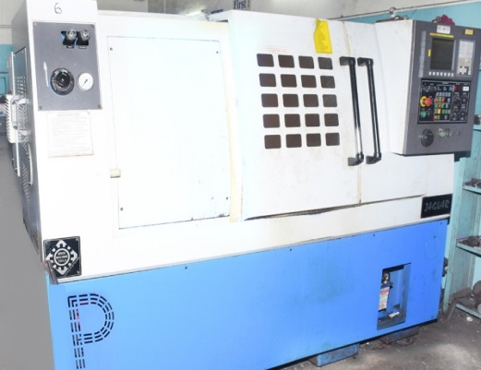
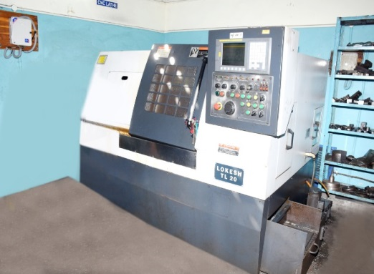
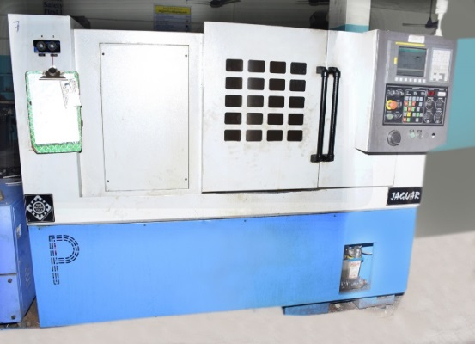
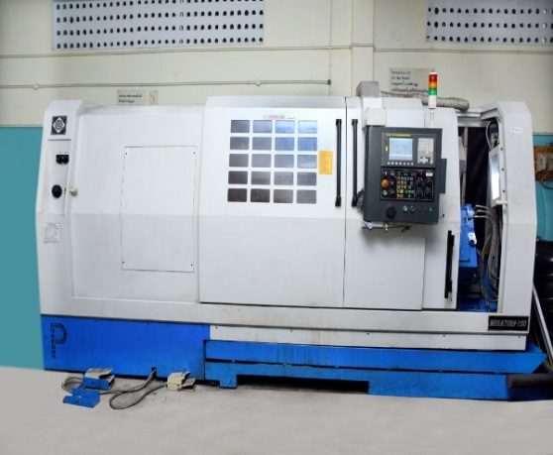
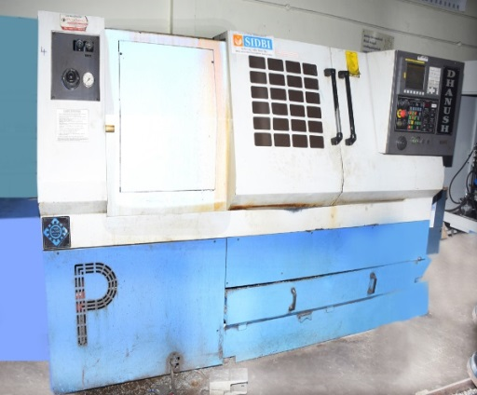
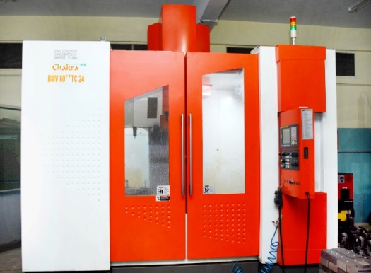
Images of Machines

Slide 9
Our Clients

Slide 10
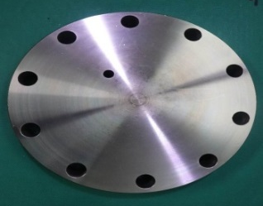
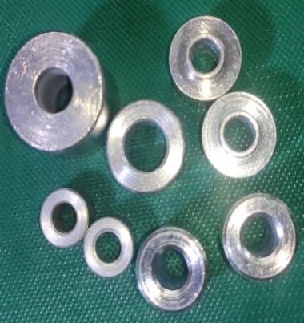
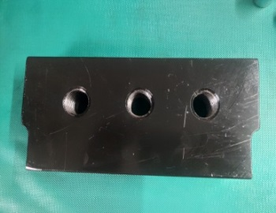
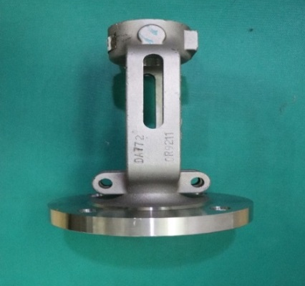
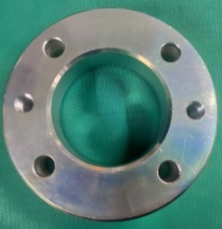
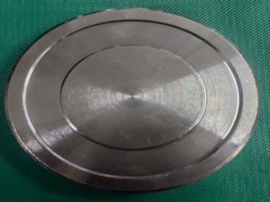
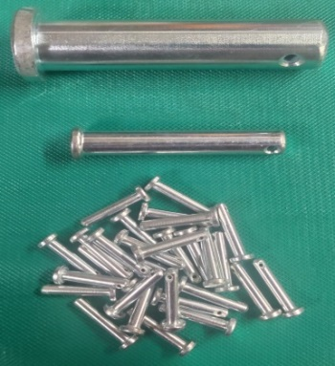
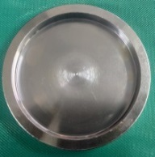
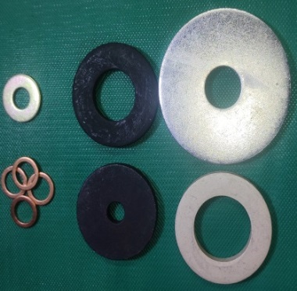
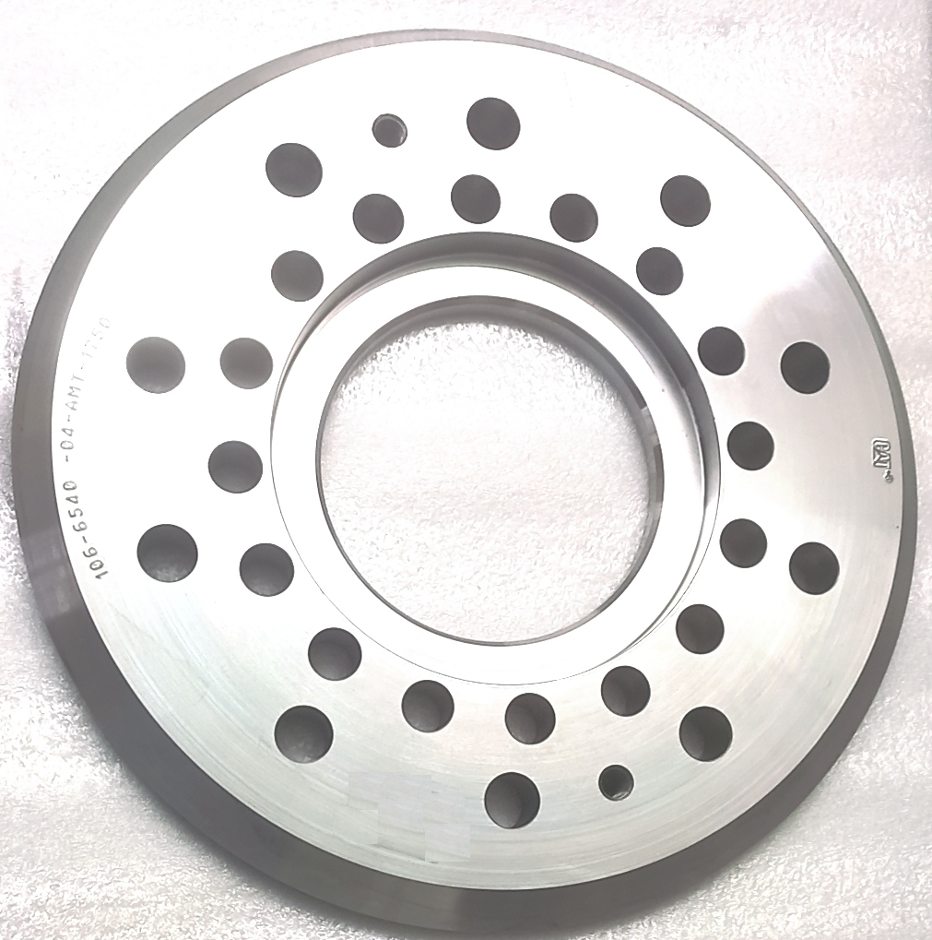
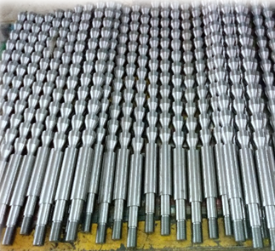
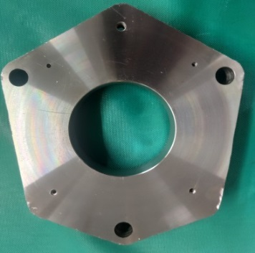
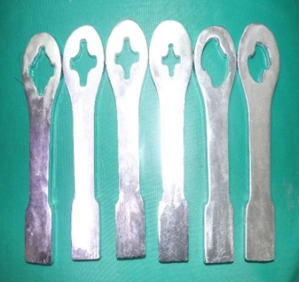
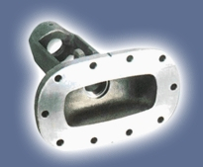
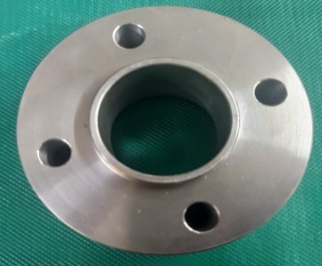
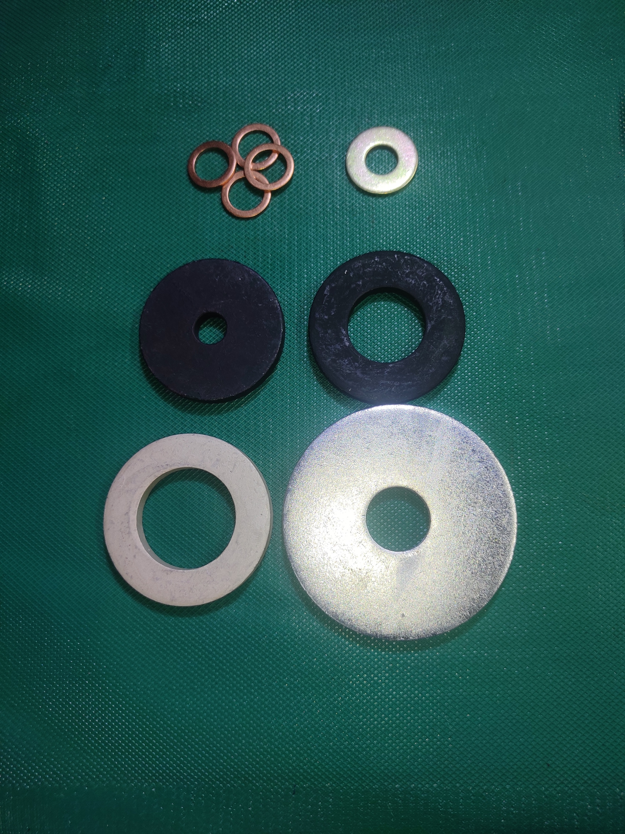
Some of Our Works
SPACER,WASHER & SPANNER
BAR, PIN , ROD & DROP BAR
BONNET
FLANGE , BUSH,CAP &COVER

Slide 11
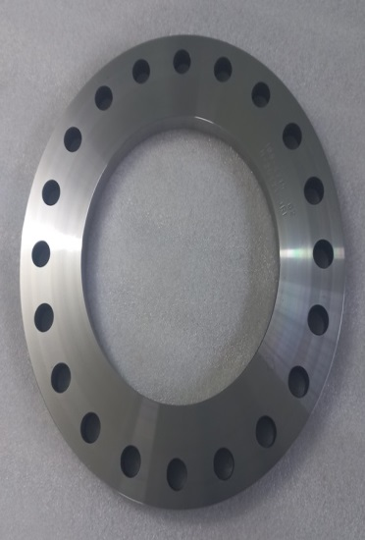
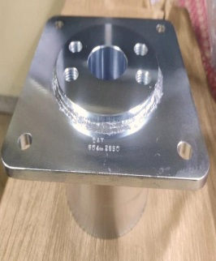
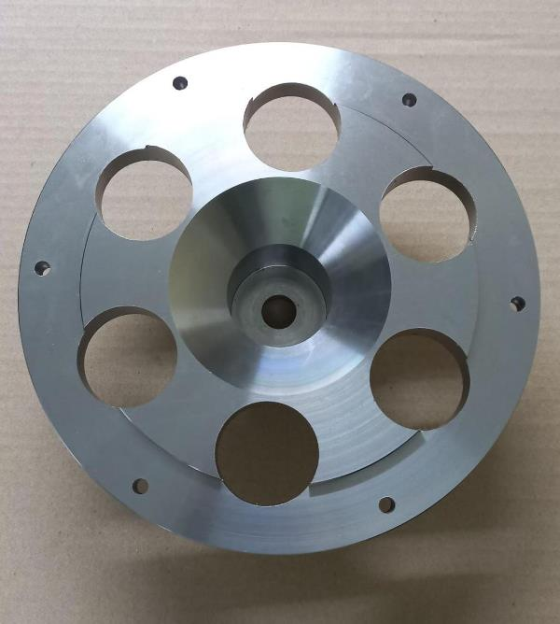
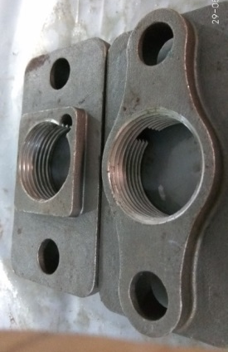
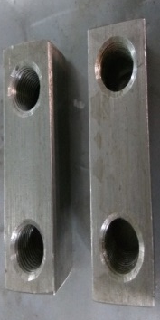
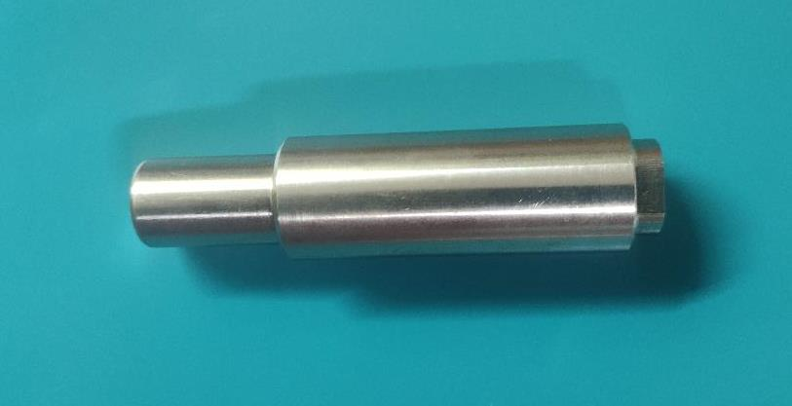
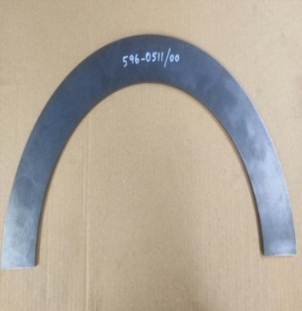
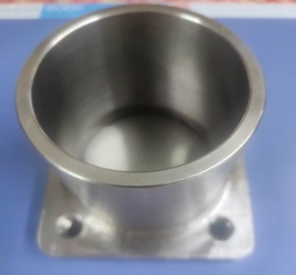
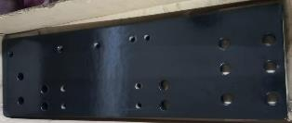
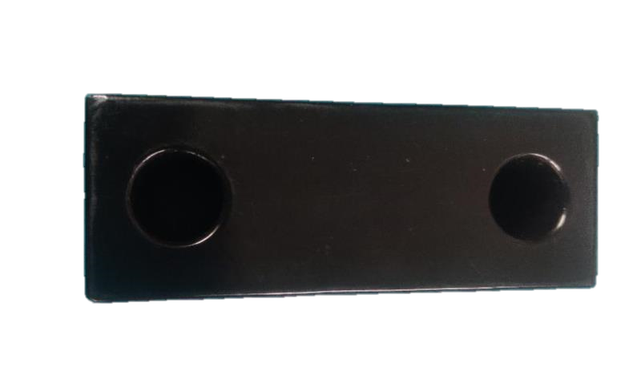
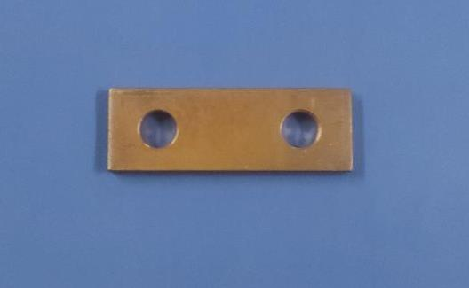
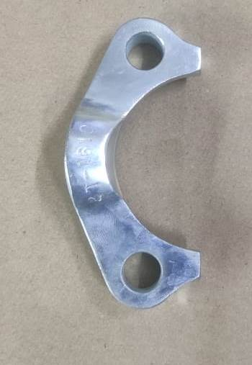
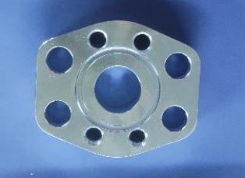
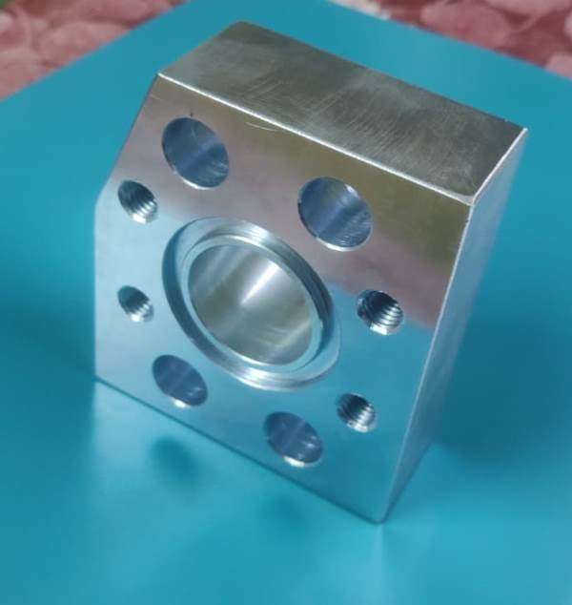
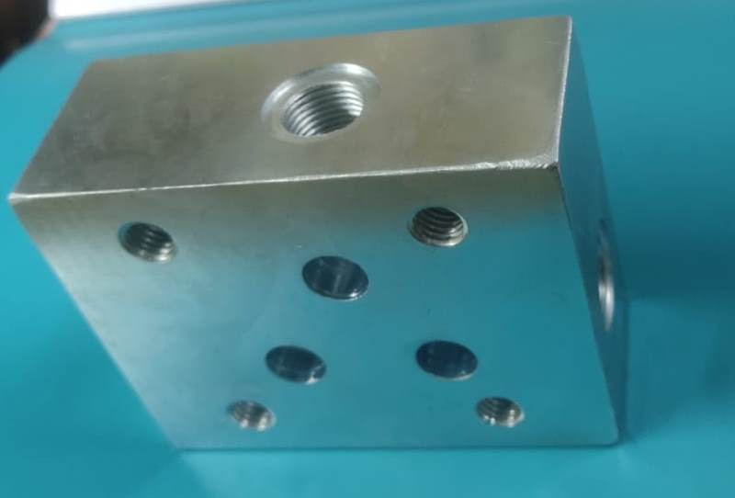
Some of Our Works

Slide 12
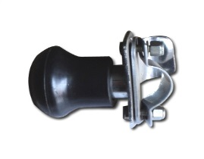
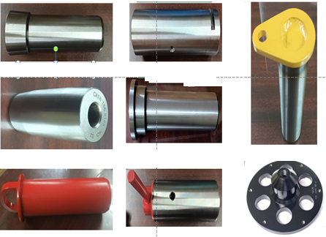
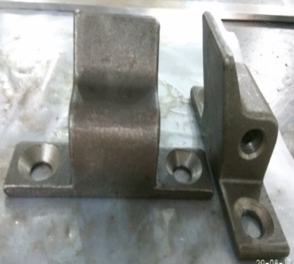
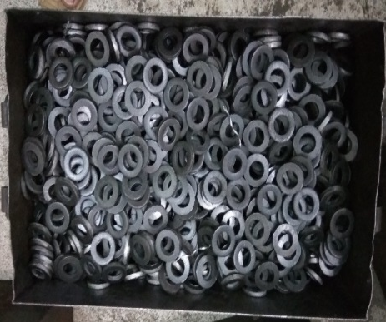
Some of Our Works

Slide 13
Contacts
Mr. K. John Rose - +91 9444274586
Mr. J. Milton John - +91 9840898305
Office - 044 - 224106010
Mail-id – jrindustries16@yahoo.co.in

Slide 14
THANK YOU

